Slide 1
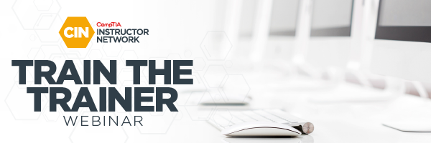
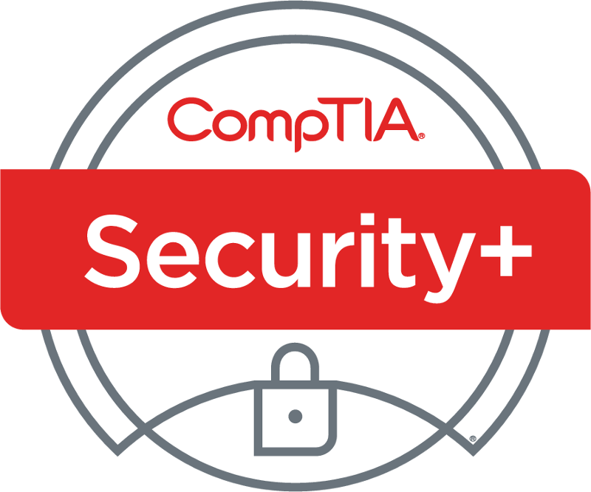
CompTIA Security+ SY0-701 TTT Session 2:
CertMaster Learn Series
October 19, 2023
@TeachCompTIA #SecPlusTTT

Slide 2
Certificate of Attendance
Contact CIN
Slides
Q&A
Bios
ON24 Help
Multimedia
Today’s Resources
Group Chat
Survey

Slide 3


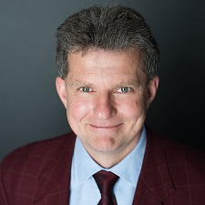
Instructor:
Brian Ford
Technical Instructor
BFord@comptia.global
Guest:
Patric Lane
Director, Product Management
CompTIA
plane@comptia.org
Host:
Stephen Schneiter
Instructor Network Program Director
CompTIA
sschneiter@comptia.org

Slide 4
Brian Ford
Frequent CINer
CompTIA Adjunct Instructor
Consultant, Coach, Content Developer
Researcher: Sec Awareness, App Sec, Threat Hunting, BEC
30-year veteran of the network & cybersecurity industry
Former Novell CNI and CCIE
B.S. Comp Sci and M.S. Info Assurance
Grad. Cert. in Teaching & Learning (Adult Ed.)
https://fordsnotes.com
Notes:
research interests include improved security awareness techniques, web application security, threat hunting, and email compromise.

Slide 5
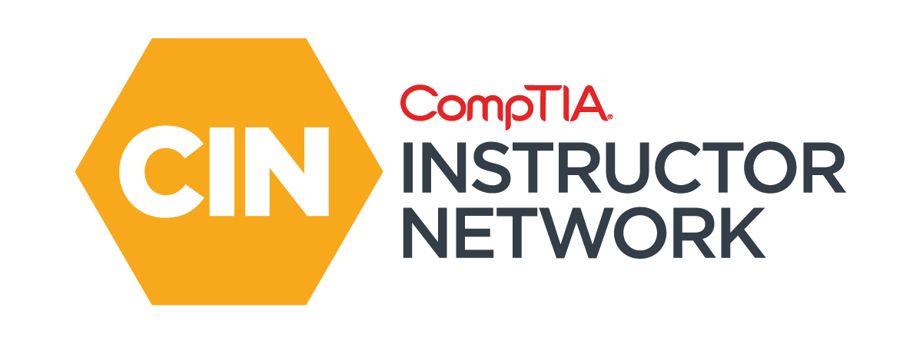
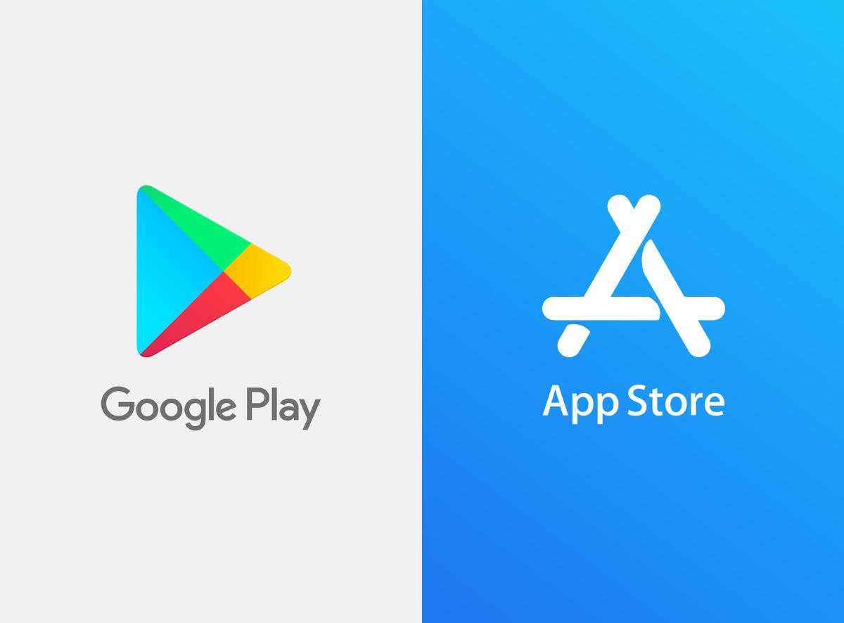
The CompTIA Instructor Network (CIN) is a worldwide community for instructors who provide CompTIA certification training.
Benefits of being a community member include:
Communicate and collaborate with CompTIA staff and other instructors.
Access resources for students to understand the value of getting certified.
Receive complimentary training and tools from CompTIA to enrich your classroom.
Become proficient at teaching CompTIA standards.
Share best practices and resources with each other.
https://cin.comptia.org
Notes:
The CompTIA Instructor Network, or CIN (pronounced sin) is a free global community open to anyone involved with training or managing a CompTIA certification program.
This community is a great place to connect with other instructors, ask questions, find resources and learn about upcoming events.
You can take CIN with you everywhere using our mobile app. Just go to the Apple or Google Play store and search for CompTIA Instructor Network to download the app.

Slide 6

Agenda
A word from the Security+ Program Manager
CertMaster Learn for Security+ Lesson 3
If time allows: Lesson 4A

Slide 7
Security+ SY0-701 CertMaster Learn TTT Session Outline
Date | Topic
1017/2023 | Security Concepts, Security Controls, Threat Actors, Attack Surfaces, Social Engineering
10/19/2023 | Cryptographic Algorithms, Public Key Infrastructure, Cryptographic Solutions
10/24/2023 | Authentication, Authorization, Identity Management, Enterprise Network Architecture, Network Security Appliances, Secure Communications
10/26/2023 | Cloud Infrastructure, Embedded Systems & Zero Trust, Asset Management, Redundancy Strategies, Physical Security, Device & OS Vulnerabilities
10/31/2023 | Device & OS Vulnerabilities, Application & Cloud Vulnerabilities, Vulnerability Identification Methods, Vulnerability Analysis & Remediation
11/02/2023 | Network Security Baselines, Network Security Capability Enhancement, Implement Endpoint Security, Mobile Device Hardening,
11/07/2023 | Application Protocol Security Baselines, Cloud & Web Application Security Concepts, Incident Response, Digital Forensics, Data Sources, Alerting & Monitoring Tools
11/09/2023 | Malware Attack Indicators, Physical & Network Attack Indicators, Application Attack Indicators
11/14/2023 | Policies, Standards, & Procedures; Change Management, Automation & Orchestration
11/16/2023 | Risk Management Processes & Concepts, Vendor Management Concepts, Audits & Assessments
11/21/2023 | Data Classification & Compliance, Personnel Policies
✓
✓

Slide 8
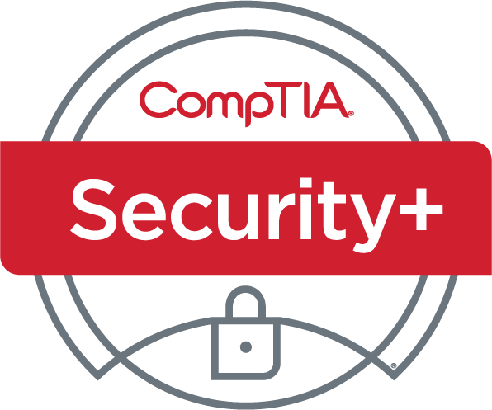
CompTIA Security+ (SY0-701)
Overview

Slide 9

CompTIA Security+ SY0-701
CompTIA Security+ is a global certification that validates the foundational cybersecurity skills necessary to perform core security functions and pursue an IT security career.
Preview Period (Pre-launch): October 3, 2023
General Availability: November 7, 2023
SY0-601 Retirement: July 31, 2024
Over 700K+ have been certified since inception in 2002.

Slide 10
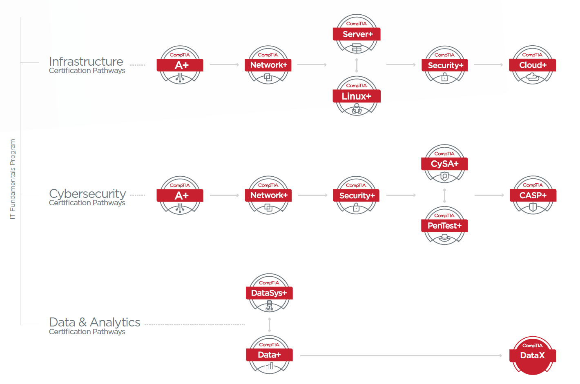
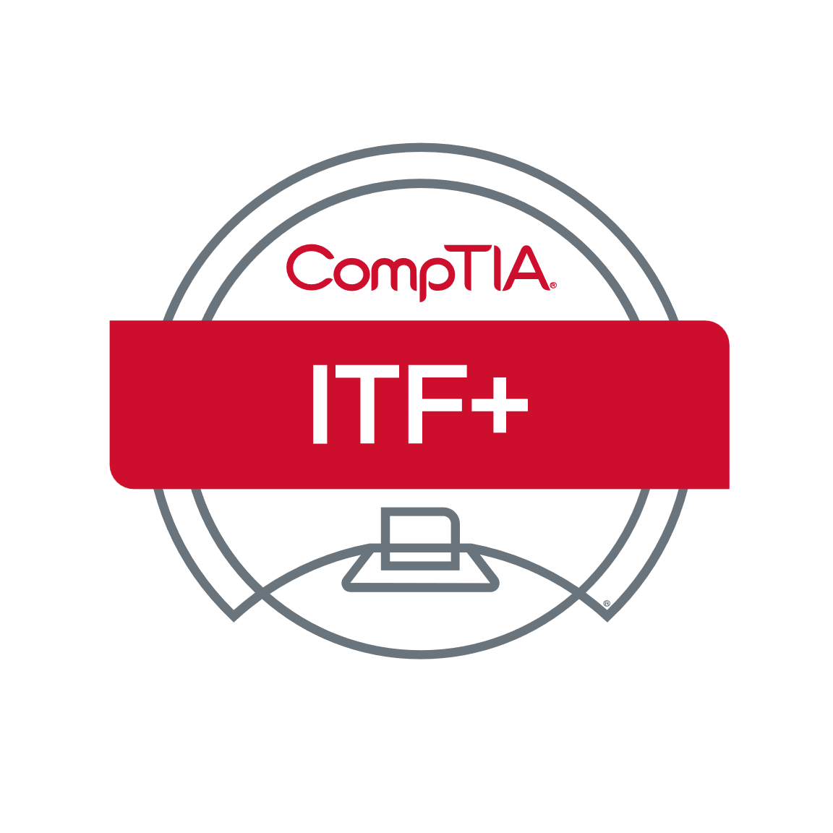

CompTIA Cybersecurity Career Pathway
*
*
*Next version of CASP+ to be renamed CompTIA SecurityX (CAS-005) for the Q4 2024 release.

Slide 11
Cybersecurity Job Market Overview
Global Cybersecurity Job Market Stats
4.7M cyber pros globally in the workforce and a 3.4M global shortage.
Global cybersecurity market value expected to grow from $155B in 2022 to $376B by 2029.
Of organizations with a shortage of cybersecurity staff, 43% said the biggest cause is not being able to find enough qualified talent.
Sources: (ISC)² Cybersecurity Workforce Study, Cyberseek

Slide 12
Security+ 701 Job Market Overview
Job Role Stats
86K job postings listed in 2023 requested CompTIA Security+.
$80K median pay for Security+ job roles in 2023.
By the Numbers
700K+ IT pros have received their Security+ certification.
24% of the total employed cybersecurity workforce in the U.S. are Security+ certified (Cyberseek).
13% of the total cybersecurity job openings request Security+ in the job req (Cyberseek).

Slide 13
Security+ 701 Differentiation
WHAT IS IT?
CompTIA Security+ is a global certification that validates the foundational cybersecurity skills necessary to perform core security functions and pursue an IT security career.
VALUE MESSAGES
Launch a Successful Cybersecurity Career. Develop a core foundation of essential skills, paving the way for a fulfilling career. More job roles use Security+ for baseline cybersecurity skills than any other certification in the industry.
Assess On-the-Job Skills. Security+ is one of the only ISO/ANSI-accredited early career cybersecurity certifications on the market with hands-on, performance-based questions on the certification exam. These practical questions assess your ability to effectively problem solve in real-life situations and demonstrate your expertise to potential employers immediately.
Embrace the Latest Trends. Understand and use the most recent advancements in cybersecurity technology, terms, techniques, and tools. By acquiring early career skills in the latest trends such as automation, zero trust, risk analysis, operational technology, and IoT, you will be well-equipped to excel in the ever-evolving cybersecurity landscape.

Slide 14
Security+ 701 – Core Cybersecurity Skills
Security+ 701 has been updated to reflect skills relevant to job roles tasked with baseline security readiness and response to address today’s threats, and to prepare candidates to be more proactive in preventing the next attack. The certification exam covers the same :
Assessing the security posture of an enterprise environment and recommend and implement appropriate security solutions.
Monitoring and securing hybrid environments, including cloud, mobile, Internet of Things (IoT), and operational technology (OT).
Operating with an awareness of applicable regulations and policies, including principles of governance, risk, and compliance.
Identifying, analyzing, and responding to security events and incidents.
20% of exam objectives were updated to include:
Current trends: The latest trends in threats, attacks, vulnerabilities, automation, zero trust, risk, IoT, OT, and cloud environments are emphasized, as well as communication, reporting and teamwork.
Hybrid environments: The latest techniques for cybersecurity professionals working in hybrid environments that are located in the cloud and on premises; cybersecurity professionals should be familiar with both worlds.

Slide 15
How is 701 different from 601?
Similar skill level: exam continues to identify early career cybersecurity skills at the two-year level.
SY0-701 has the same number of exam domains (5) but fewer objectives (28 vs. 35) due to a more focused job role in a maturing industry.
Related job roles are similar, although the work of a security administrator has become more defined, and the skills performed are identified with more accuracy. NICE work roles increased.
4. Several exam domains and exam objectives were re-ordered and re-named to address instructional design improvements.
Bloom’s taxonomy indicates more application of skills and slightly less analysis overall.
Governance, Risk and Compliance (GRC) tasks are better defined for cybersecurity professionals with more focus on reporting and communication, as opposed to the minutia of different regulatory standards and their processes.
Security+ 701 | Security+ 601 Equivalent
1.0 General Security Concepts 12% 2.0 Threats, Vulnerabilities & Mitigations 22% 3.0 Security Architecture 18% -- 4.0 Security Operations 28% 5.0 Security Program Management and Oversight 20% | -- 1.0 Threats, Attacks and Vulnerabilities 24% 2.0 Architecture and Design 21% 3.0 Implementation 25% 4.0 Operations and Incident Response 16% 5.0 Governance, Risk and Compliance 14%

Slide 16
Job Role Comparison
SY0-701 Job Roles
Primary Job Roles:
Security Administrator
Systems Administrator
Secondary Job Roles:
Help Desk Analyst
Security Engineer
Security Analyst
NICE Work Roles (18)
SY0-601 Job Roles
Primary Job Roles:
Security Administrator
Systems Administrator
Secondary Job Roles:
Helpdesk Manager / Analyst
Security Engineer / Analyst
Network / Cloud Engineer
DevOps / Software Developer
IT Auditors
IT Project Manager

Slide 17
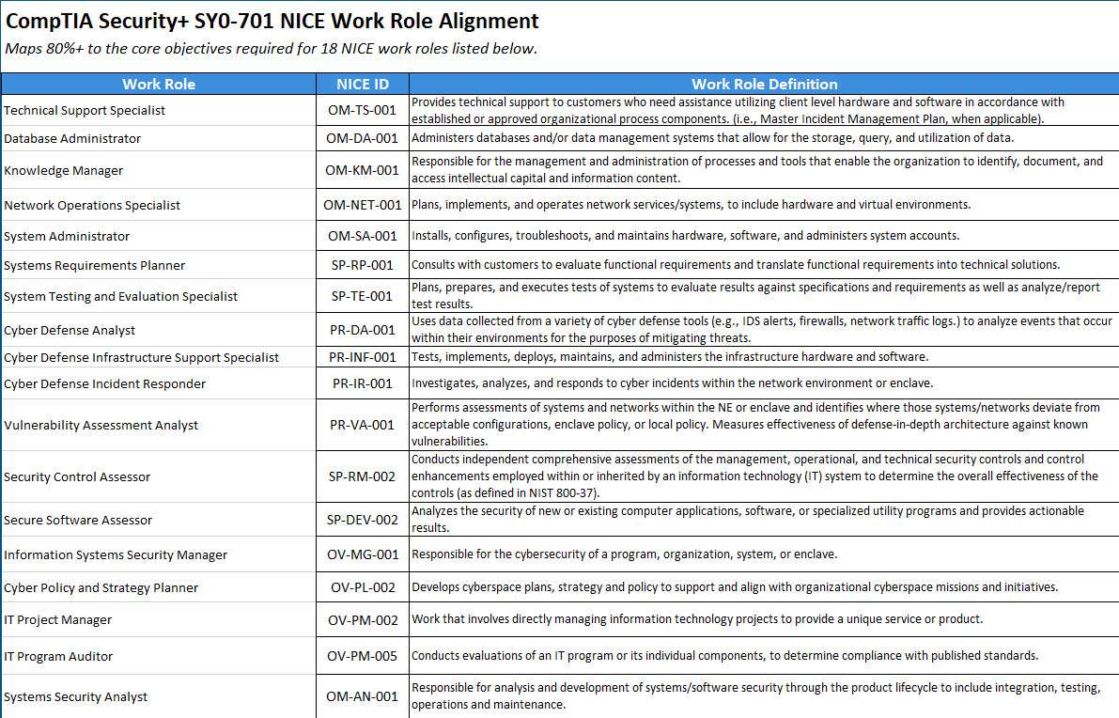

Slide 18
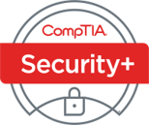
Organizations that Assisted in SY0-701 Development
Subject matter experts (SMEs) from the following organizations assisted with the development of SY0-701. Some of the biggest contributors are listed below.
Wells Fargo
Nationwide
Johns Hopkins University Applied Physics Laboratory
Fidelis Risk Advisory
Lippert Components
Cyber Warfare Tactics LLC
Organon
Blue Chip Talent
Deakin University
Growth Arbor
Linford and Company LLC
MindPoint Group
Brotherhood Mutual
SS&C Technologies
Five9
Fidelity Investments
Zoom
Microsoft
SenseOn
U.S. Navy Center for Information Dominance
L3Harris
SecureWorks
General Dynamics IT (GDIT)
Washington State Patrol
Contentful
Deloitte

Slide 19
Security+ SY0-701 Exam Details
Item | Description
Exam code | SY0-701
Launch Date | Preview: October 3, 2023 General Availability: November 7, 2023
Availability | Worldwide
Retail Price | $392 USD
Testing Provider | Pearson VUE Testing Centers, OnVUE
Question Types | Performance based and multiple choice
No. of Questions | Maximum of 90 questions
Length of Test | 90 minutes
Passing Score | 750 (on a scale of 100-900)
Languages | English, with Japanese, Portuguese and Spanish to follow
Recommended Experience | CompTIA Network+ and two years of experience working in a security/ systems administrator job role
Exam retirement | SY0-601 to retire July 31, 2024 (English) with other languages to follow

Slide 20
Security+ 701 Learning & Training Products
CompTIA Products
CertMaster suite
CertMaster Learn
CertMaster Labs
CertMaster Practice
Study guides
Live online training (LOT)
Bundles
Test Out Products
Security Pro (academic)

Slide 21
Section break
CertMaster Learn for Security+ Lessons 3

Slide 22
POLL
Do you use demonstrations as part of your class?
Yes! I use live demos.
Yes. I use live and recorded demos.
Yes. I use recorded demos or videos from CertMaster.
No. I don’t use demos.

Slide 23
Lesson 3 Explaining Appropriate Cryptographic Solutions
Objectives
Compare and contrast cryptographic algorithms
Explain the importance of public key infrastructure and digital certificates
Explain the importance of using appropriate cryptographic solutions for encryption and key exchange

Slide 24
Topic 3A
Cryptographic Algorithms

Slide 25
Cryptographic Concepts​
Encryption and decryption—encoding and decoding​
Plaintext is the unencoded message​
Ciphertext is the coded message​
Cipher is the means of change or algorithm​
Cryptanalysis is the art of cracking cryptographic systems​
Hashing algorithms​
Encryption uses a reversible process (algorithm) based on a ​key that is only known by authorized persons
Encryption ciphers​
Symmetric​
Asymmetric​​
Notes:
Note that in cryptography there is still some "obscurity" involved as you have to control distribution of the key. This is a simpler job than protecting the design of the algorithm, however.
Passive eavesdropping is traditionally performed by a character named Eve, but we're just using Mallory for simplicity.

Slide 26
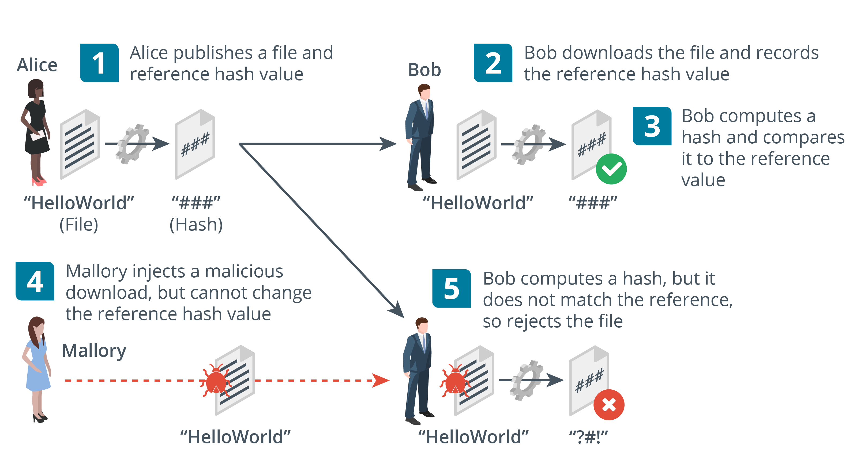
Hashing
Fixed length digest from variable string with cryptographic properties​
One-way (plaintext cannot be recovered from the digest)​
Anti-collision (no two plaintexts are likely to produce the same digest)​
Used for password storage and checksums (integrity)​
Secure Hash Algorithm (SHA)​
256-bit or better
Message Digest Algorithm (MD5)​
128-bit only
Images © 123rf.com.
Notes:
Hash functions are mostly used for integrity (signatures and message authentication codes) and password storage (confidentiality).
RIPEMD is also listed as an acronym so you might want to make students aware of it as an alternative to SHA.

Slide 27
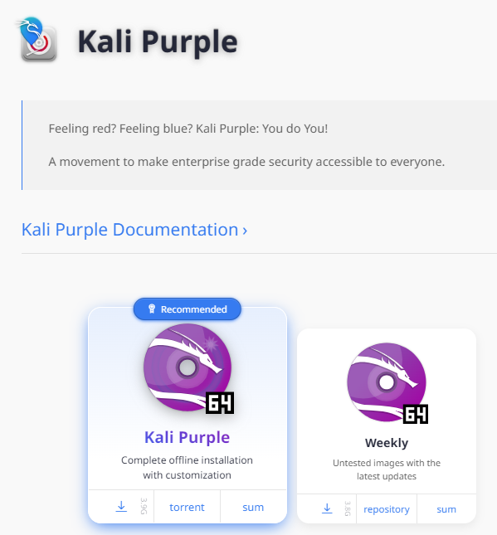
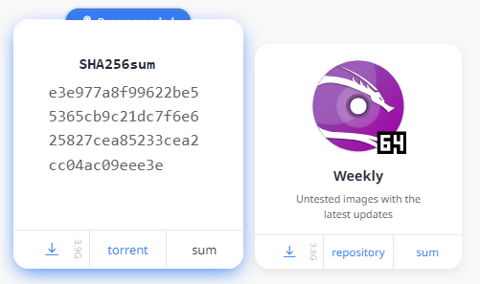
Hashing Used to Check File Integrity (1)
Download
Checksum
https://www.kali.org/get-kali/#kali-installer-images

Slide 28
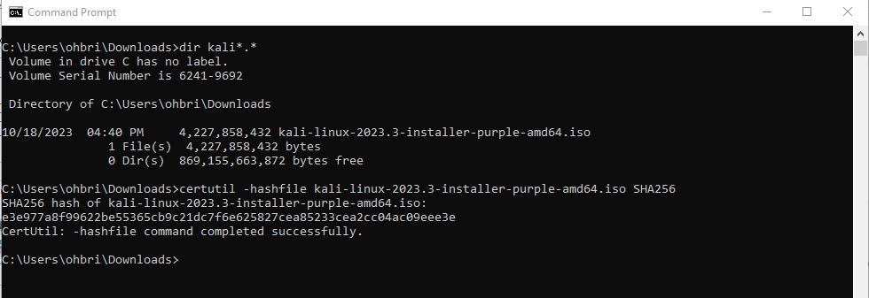
Hashing Used to Check File Integrity (2)

Slide 29
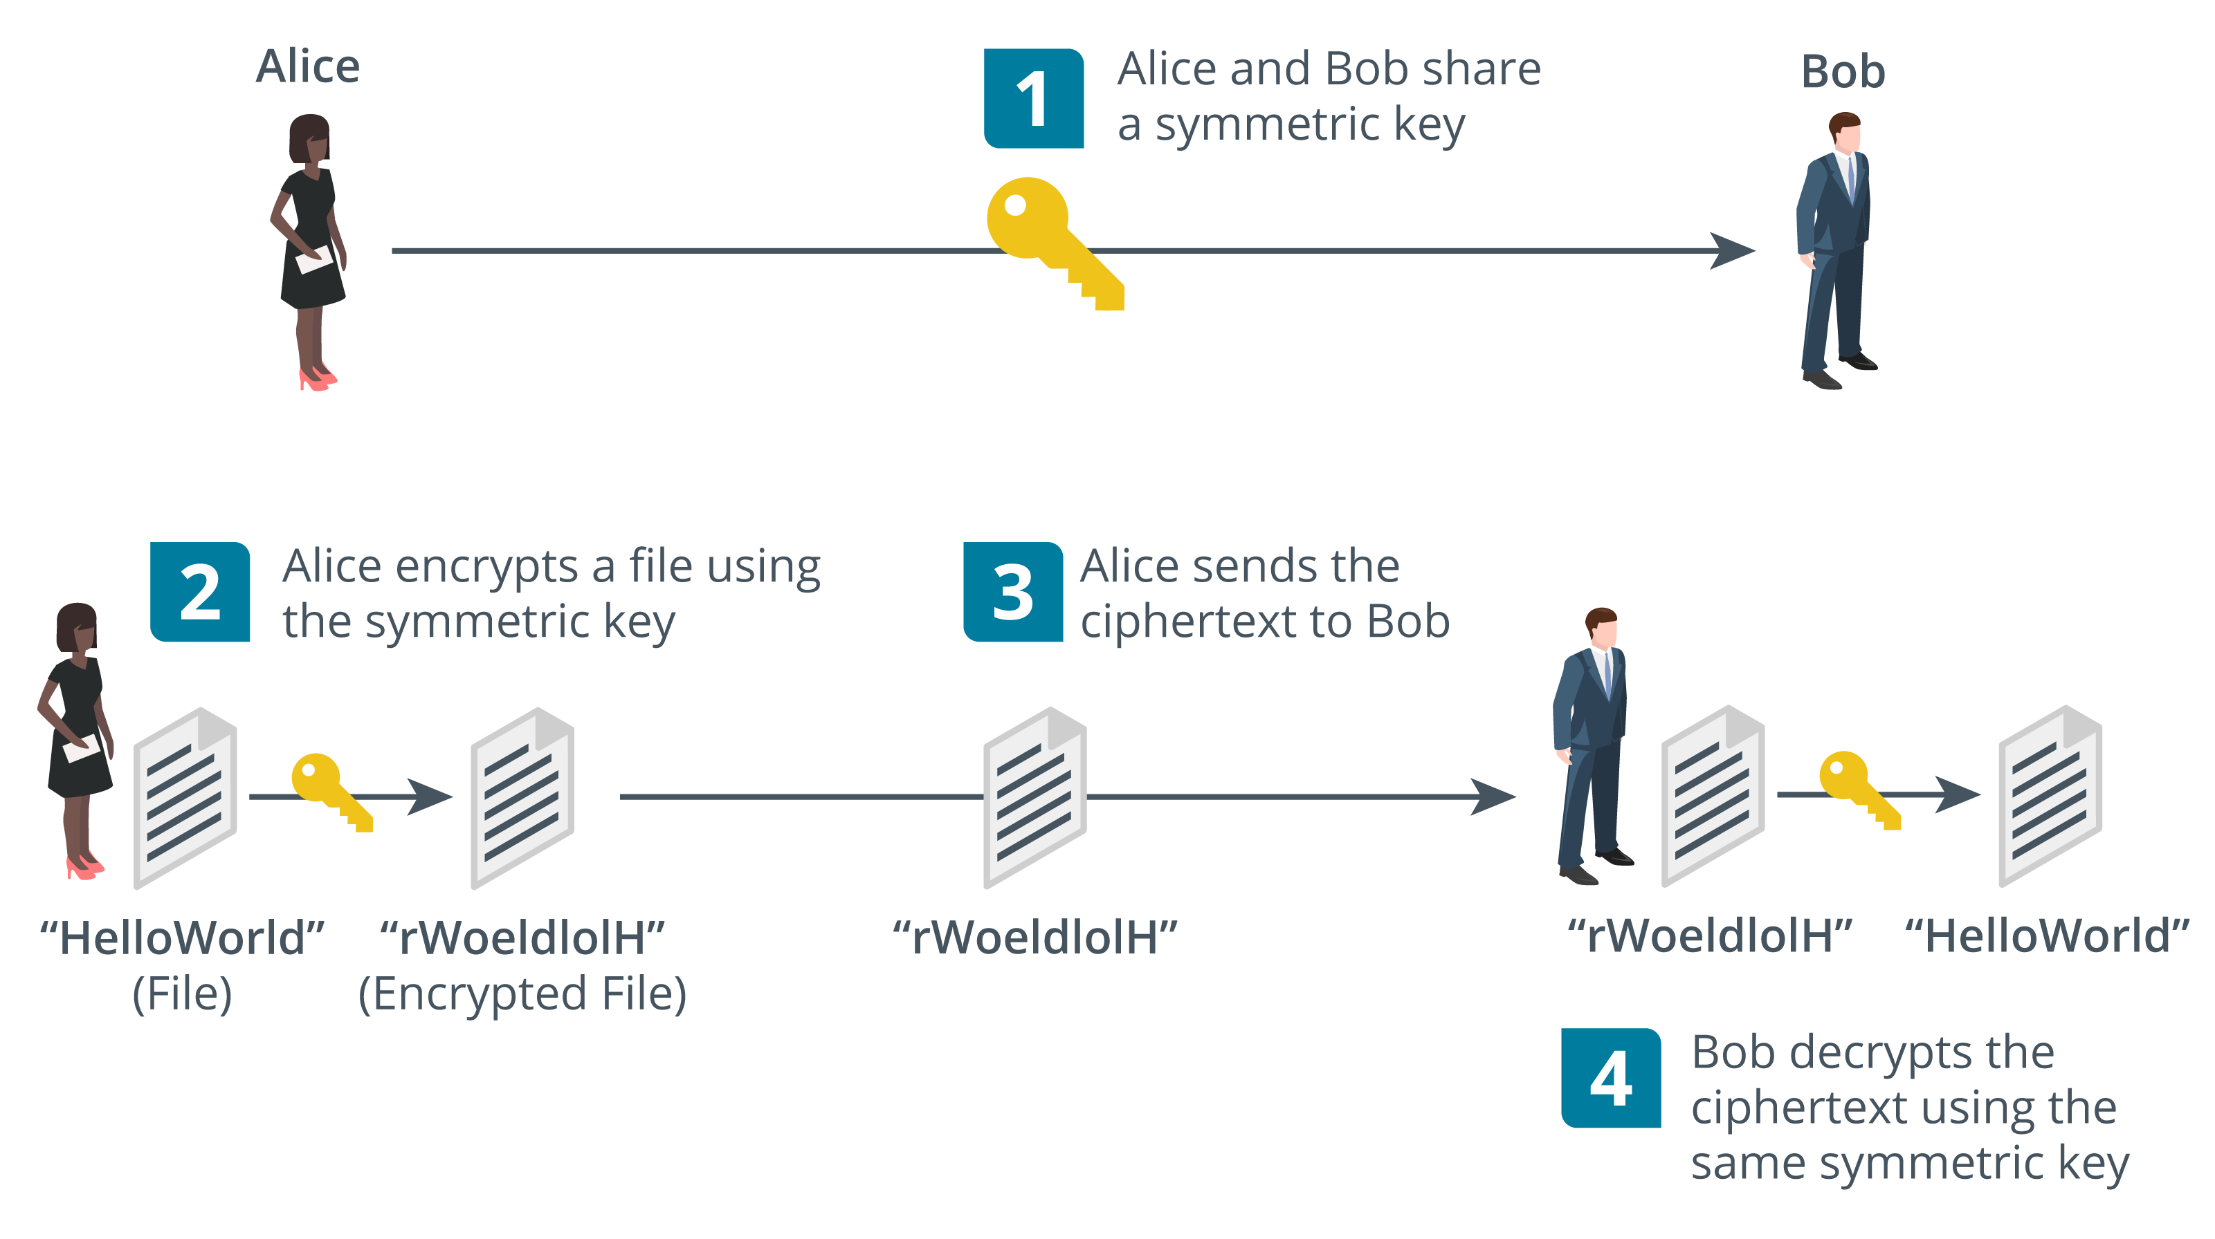
Symmetric Encryption
Substitution​ and transposition​
Process should be too complex to unravel without the key​
Symmetric algorithms
Same secret key is used for encryption and decryption​
Fast—suitable for bulk encryption of large amounts of data​
Problem storing and distributing key securely​
Confidentiality only— sender and recipient know the same key​
Notes:
Make sure students understand the difference between the algorithm and the key.
Note that symmetric encryption is mostly used for privacy (confidentiality). Test that the students can explain to you why it cannot be used for authentication, integrity, or non-repudiation.
While the names of cryptographic algorithms have been removed from the certification objectives, they are still present in the acronyms list, and the injunction on the acronyms list is "Candidates are encouraged to review the complete list and attain a working knowledge of all listed acronyms as part of a comprehensive exam preparation program." Consequently, the names of some products have been retained.
Acronyms related to block ciphers/modes of operation are still present, but we are not covering this subject as it is complex and no longer listed as an exam subobjective. You might want to point students toward other sources to learn about these: CBC, CFB, CTM, ECB, GCM.

Slide 30
A single shared key: Symmetric Encryption

Slide 31
Key Length
Key ensures ciphertext remains protected even when the operation of the algorithm is known​
Range of key values is the keyspace​
Longer key bit length means a larger keyspace​
Protects against brute force cryptanalysis
Advanced Encryption Standard (AES)​
There are 3 AES algorithms: AEC128, AES 192, and AES 256
256-bit key is exponentially stronger than 128-bit key
Larger keys use more CPU/memory/power resources
Notes:
Note that AES doesn't have weak keys. However, if the implementation uses weak random number generation, the keys will be much more vulnerable to cryptanalysis.
DES and RC4 remain in the acronyms list. You might want to mention these weak ciphers are no longer recommended for use. We're omitting discussion of IDEA and RACE too.

Slide 32
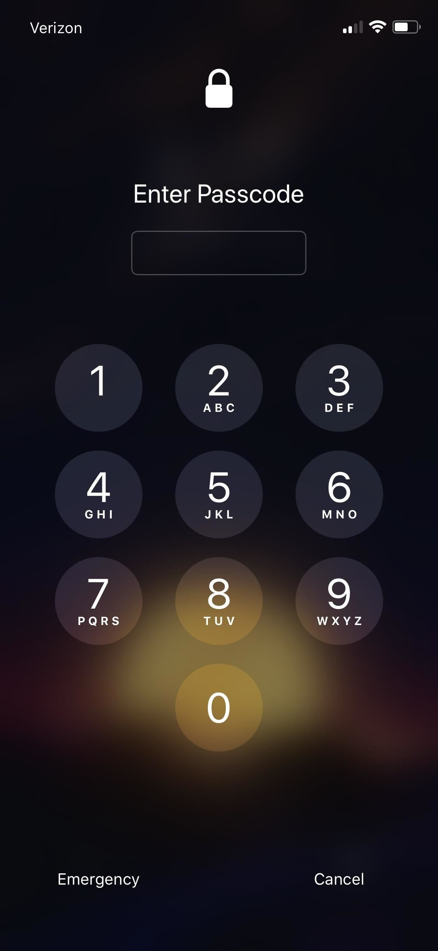
Keyspace: What if we attacked a locked iPhone?
The Apple iPhone supports a 4-digit passcode
Numbers 0-9 (10 digits)
Each digit in passcode has 10 choices (0-9)
Total possible passcodes is 10^4 (10,000 possible unique passcodes)
Given a brute force attack
The attacker would have to enter up to 10,000 entries.
The keyspace is 10,0000 possible entries

Slide 33
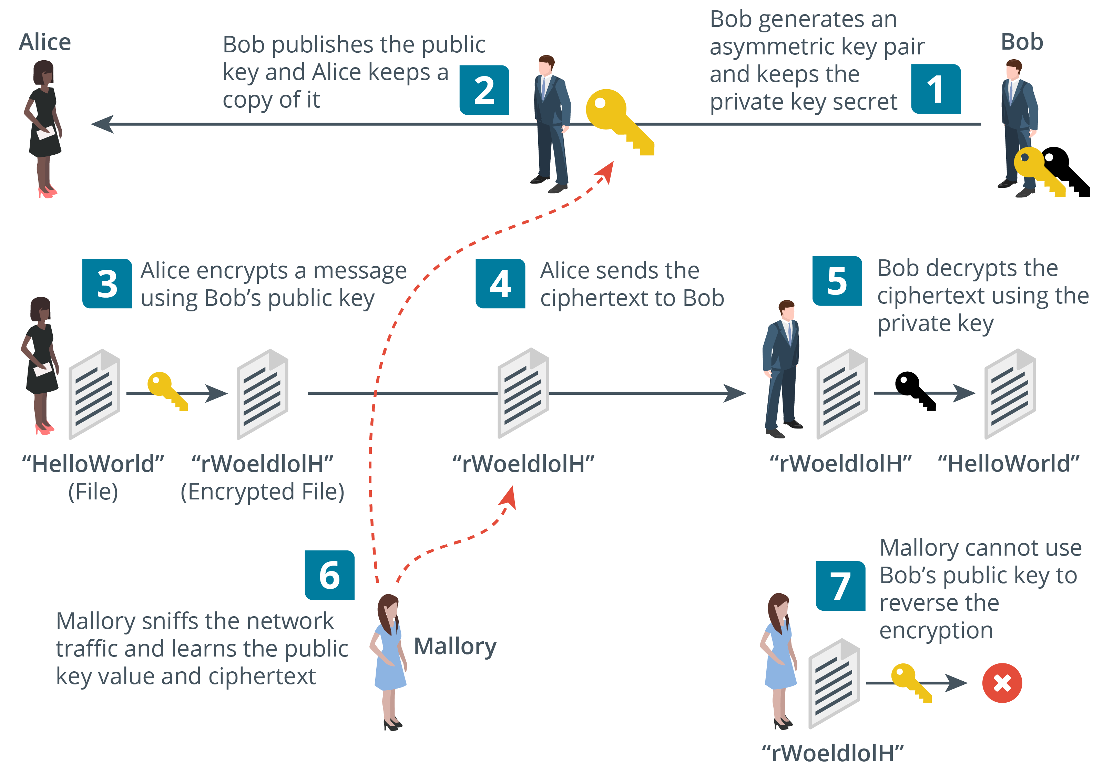
Asymmetric Encryption​
Public/private key pair​
If the public key encrypts, only the private key can decrypt​
Private key cannot be derived from the public key​
Private key must be kept secret​
Public key is easy to distribute (anyone can have it)​
Used for small amounts of authentication data​
Different ciphers have different recommended key lengths
Rivest, Shamir, Adelman (RSA) cipher (2,048-bit or better)
Elliptic Curve Cryptography (ECC) cipher (256-bit or better)

Slide 34
A two key system: Asymmetric Encryption

Slide 35
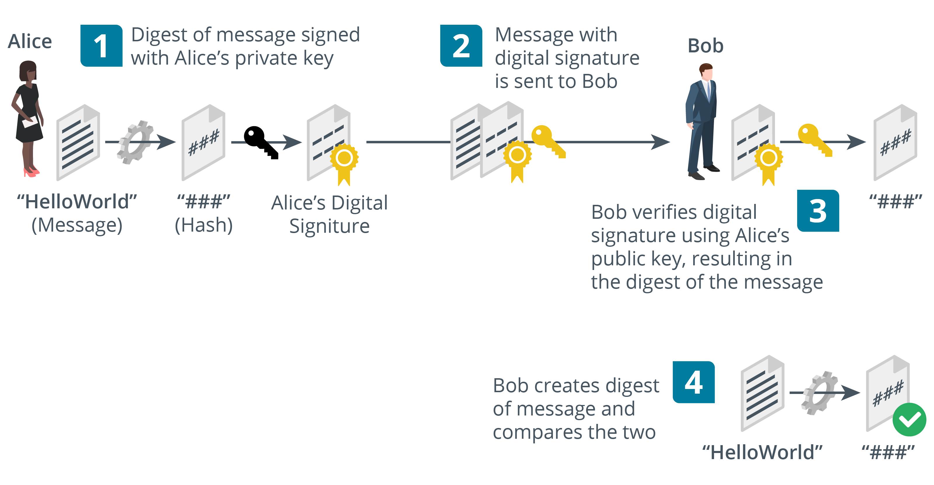
Digital Signatures​
Using public key cryptography with hashing​
Digital signatures provide integrity, authentication, non-repudiation​
Note: Using a Digital Signature, the message
passes in the clear! Alice has ‘proof’ that Bob sent the message. An example of non-repudiation.
Notes:
Digital signatures combine public key cryptography with hashing algorithms to provide authentication, integrity, and non-repudiation.

Slide 36
Notes for 3A:
Acronyms related to block ciphers/modes of operation are still present, but we are not covering this subject as it is complex and no longer listed as an exam subobjective.
You might want to point students toward other sources to learn about these: CBC, CFB, CTM, ECB, GCM.
DES and RC4 remain in the acronyms list. You might want to mention these weak ciphers are no longer recommended for use. We're omitting discussion of IDEA and RACE too.

Slide 37
Topic 3B
Public Key Infrastructure

Slide 38
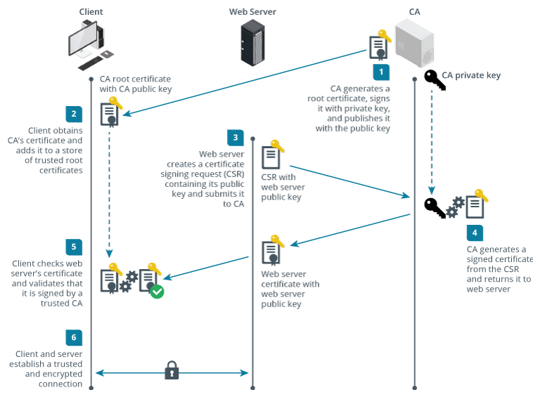
Certificate Authorities​
Public key infrastructure (PKI)
Prove identity of a public key holder (subject user or computer)
Certificate authority (CA)
Repository of certificates and public keys issued to verified subjects
Third-party CA
Entity that has established widespread trust in its policies and procedures for issuing certificates
Notes:
This is a quick recap of the previous topic. Be sure that students grasp the use of public and private keys before moving on.

Slide 39
Using Certificates
Gold =
Public Key
Black =
Private Key

Slide 40
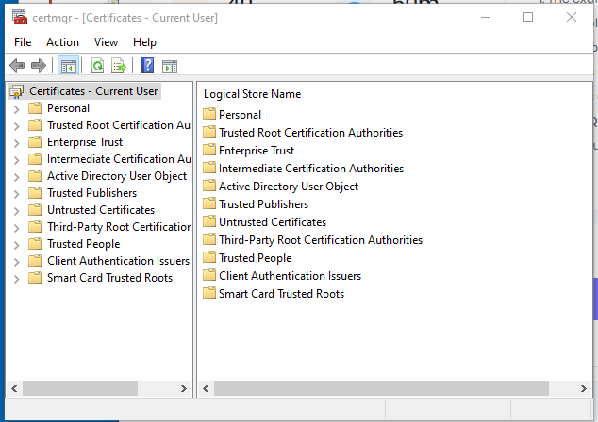
Windows Certificate Manager

Slide 41
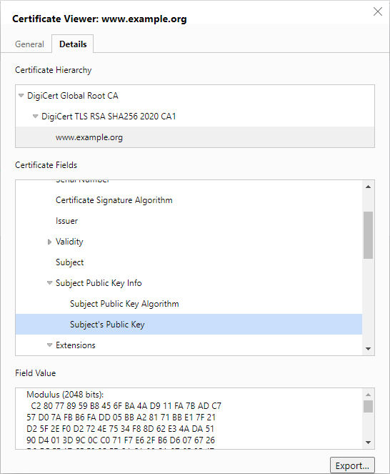
Digital Certificates​
Contains subject’s public key​
Information identifying the subject plus usage and validity​
Digital certificate standards​
X.509 Public Key Infrastructure (PKIX)​
PKCS (Public Key Cryptography Standards)​​
X.509 and PKCS standards aren't listed in the exam objectives (though PKCS is in the acronyms list), so students should not need to learn them.
Notes:
X.509 and PKCS standards aren't listed in the exam objectives (though PKCS is in the acronyms list), so students should not need to learn them. We include them here just for reference.

Slide 42
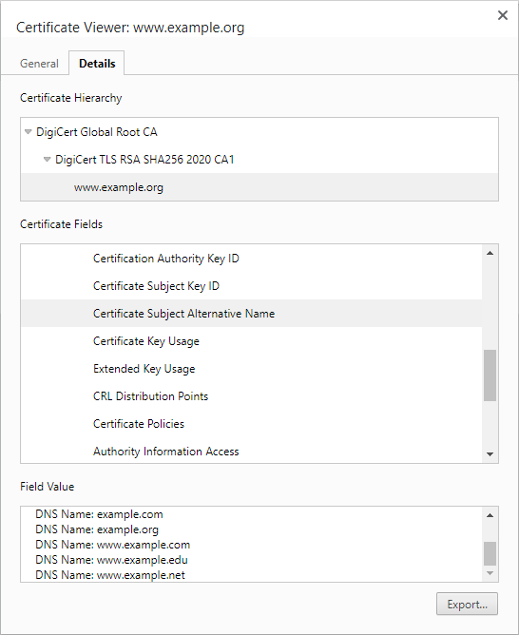
Root of Trust​
Root certificate
Self-signed, so users must trust in the CA’s security procedures
Single CA​
CA issues certificates directly to subjects
Hierarchical/chain of trust​
Root CA​
Intermediate CAs​
Leaf certificates​
Self-signed certificates
Use certificate security without PKI, but provide no root of trust
Screenshot used with permission from Microsoft.
Notes:
Show a certificate hierarchy for a website (such as example.org).
Show the trust store for a Windows or Linux PC or for a web browser.

Slide 43
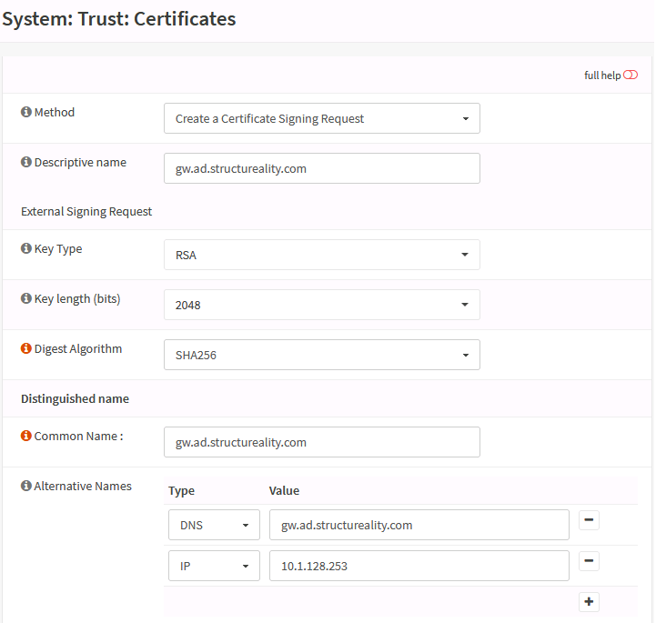
Certificate Signing Requests
Registration identification and authentication procedures​
Certificate Signing Request (CSR)​
Subject generates key pair and sends public key to CA with CSR​
Subject does NOT send private key: this must be kept known to the subject
CA performs subject identity checks​
CA signs and issues certificate​

Slide 44
Subject Name Attributes​
Common Name (CN)​
Legacy method of recording fully qualified domain name (FQDN​)
Deprecated by standards​
BUT still used in many implementations​
Subject Alternative Name (SAN)​
Structured identifiers​: name and/or IP address
List multiple host/subdomains​
Use wildcard subdomain​​
Screenshot used with permission from Microsoft.

Slide 45
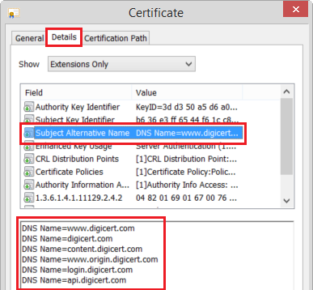
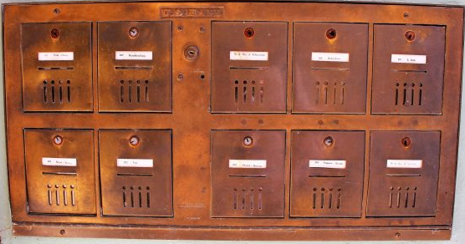
Subject Alternative Name (SAN)
Data field in digital certificate record that lets you specify additional host names (sites, IP addresses, common names, etc.) to be protected by a single SSL/TLS Certificate, such as a Multi-Domain (SAN) or Extended Validation Multi-Domain Certificate.
Like mailboxes at the Post Office. One street (or IP) address with many individual boxes (SAN).

Slide 46
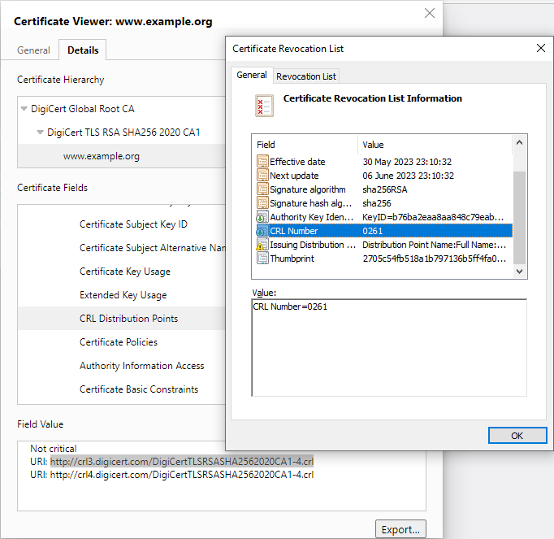
Certificate Revocation​
Revocation versus suspension​
Reason codes​
Certificate Revocation List (CRL)​
List of revoked and suspended certificates​
Browser CRL checking​
Online Certificate Status Protocol (OCSP) ​
Client queries single certificate per transaction​
Provide real-time status information (though some rely on CRLs)​
Screenshot used with permission from Microsoft.

Slide 47
Key Management​
Key lifecycle​
Key generation​
Storage​
Revocation​
Expiration and renewal​
Decentralized key management
Each host or user account stores its own private key
Key management system
Keys are generated and stored on a centralized server
Key Management Interoperability Protocol (KMIP)
Notes:
SSH is covered later in the course.

Slide 48
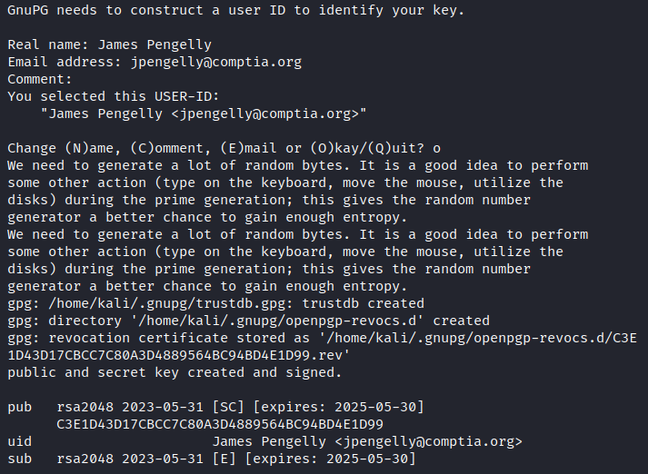
Cryptoprocessors
Key generation challenges
Entropy and random number generation
Tamper-evident storage
Trusted Platform Module (TPM)​
Cryptoprocessor implemented on CPU (or motherboard)
Hardware Security Module (HSM)​
Cryptoprocessor in removable or dedicated hardware form factor (or virtual appliance)
Reduced attack surface and tamper-evident​

Slide 49
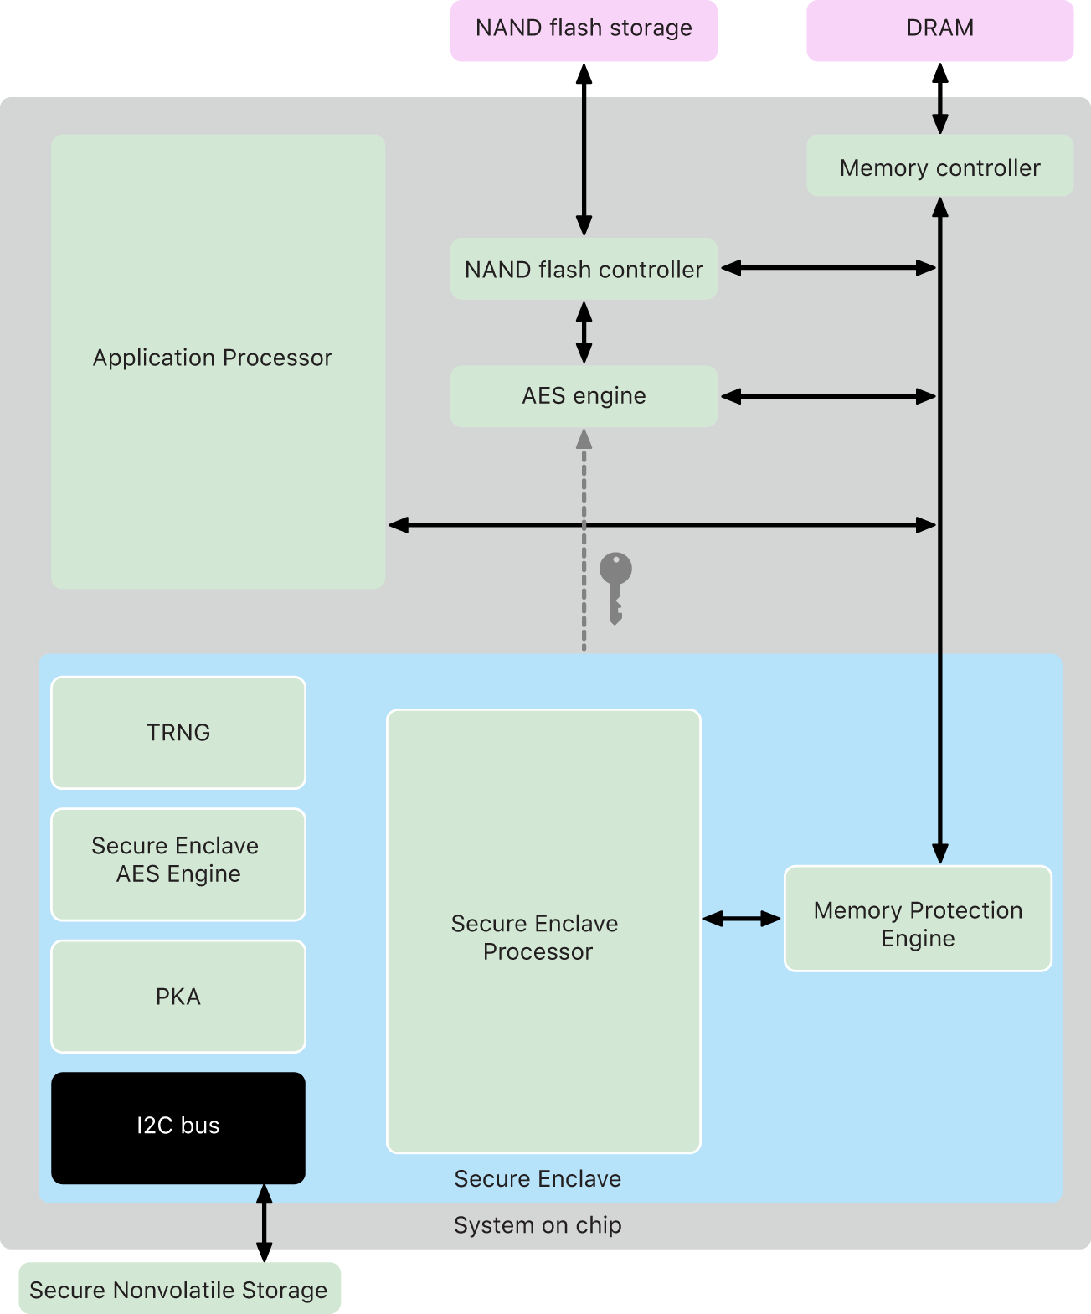
Secure Enclave
Protects keys loaded in system memory
“The Secure Enclave is a dedicated secure subsystem integrated into Apple systems on chip (SoCs). The Secure Enclave is isolated from the main processor to provide an extra layer of security and is designed to keep sensitive user data secure even when the Application Processor kernel becomes compromised.”
https://support.apple.com/guide/security/secure-enclave-sec59b0b31ff/web

Slide 50
Key Escrow​
Keys can be backed up to protect against data loss​
Anyone with access to backup keys could impersonate the true key holder​
Escrow backup​
Placing archived keys with a trusted third party​
M-of-N control
Key recovery processes can be protected by M of N control​
Split key into multiple parts held by different key recovery agents
A feature often found in HSM
See vendors Hytrust & Thales

Slide 51
Topic 3C
Cryptographic Solutions

Slide 52
Encryption Supporting Confidentiality
Data states
Data at rest
Windows Bitlocker
Data in transit
VPN
Data in use
Often requires specialized hardware such as HSM or enclave
Bulk encryption
Using a private asymmetric key is inefficient for large amounts of data
Private key (key encryption key) is used to encrypt a symmetric key (media/data encryption key)

Slide 53
Disk and File Encryption
Data at rest storage levels
Full disk and partition encryption
Encrypt whole disk or partition on disk
Often performed by drive firmware (self-encrypting drive or SED)
SED includes crypto processor with drive controller
Offloads crypto processing from CPU
Volume and file encryption
Often performed by OS/software
Windows Bitlocker
Usually requires file system support
Notes:
We're drawing some distinctions among disk, partition, and volume encryption that aren't necessarily observed in the marketplace. Most products are just sold as disk/drive/device encryption.

Slide 54
Database Encryption
Structured data
Tables, columns (fields), and rows (records)
Database Management System (DBMS)
Structured Query Language (SQL)
Database-level encryption
Page-level decryption and encryption as data is moved from disk to memory
Record-level encryption
Cell/column versus record-level
Enforce fine-grained access controls to support compliance requirements for privacy/security

Slide 55
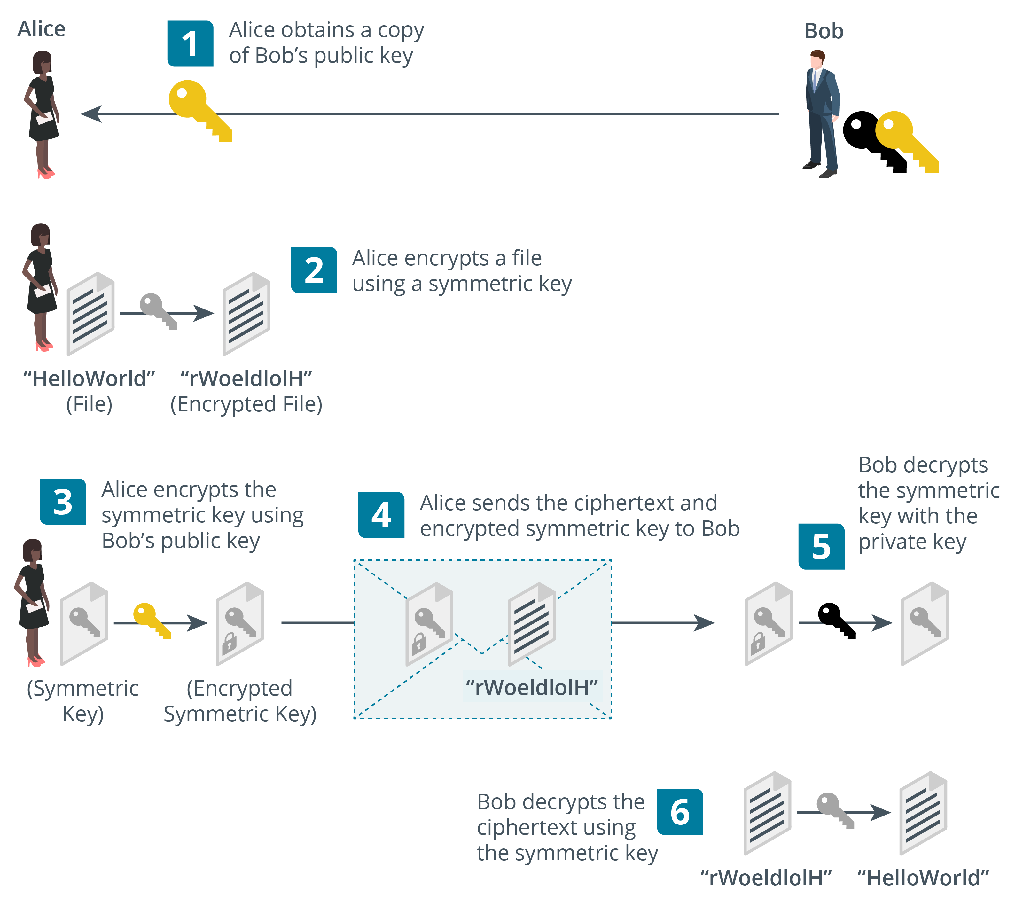
Transport Encryption and Key Exchange
Notes:
HMAC and authenticated encryption aren't content examples, but they seem worth mentioning. HMAC is in the acronyms list.

Slide 56
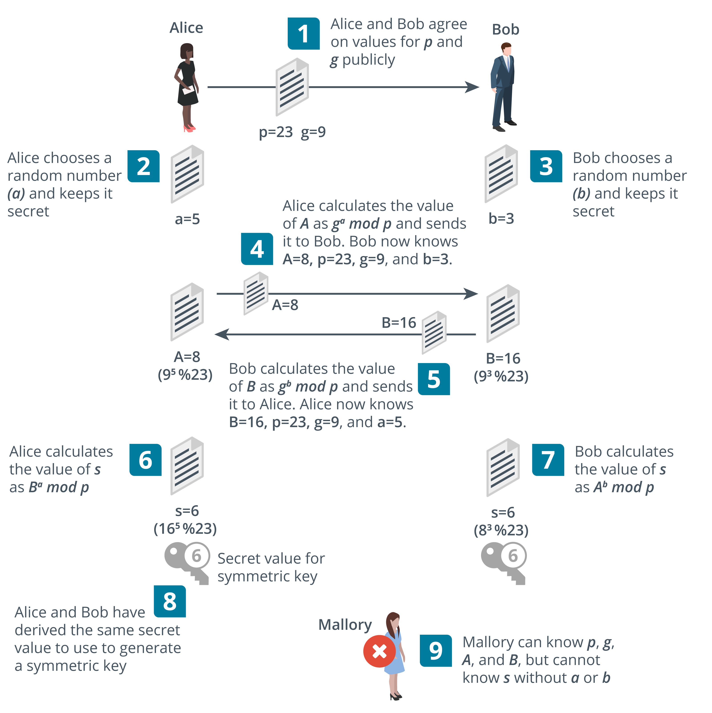
Perfect Forward Secrecy
Important note for Instructors. In TLS 1.3, only PFS cipher suites are allowed. RSA key exchange is deprecated. The RSA algorithm can still be used for signing, however. The values exchanged as part of D-H need to be signed to prove authenticity and prevent an on-path attack
Notes:
The exam objectives only mention "key exchange," but PFS is so critical to modern security it needs covering.
The terms "key exchange" and "key agreement" are often taken to mean the same thing, but point out that there are different mechanisms. With key agreement, the client does not transmit an encrypted session key to the server. The client and server use Diffie-Hellman (D-H) to derive the same secret key value.

Slide 57
Salting and Key Stretching
Password hashes
User-generated data is low entropy​
Brute force attack discovers value by generating every possible value and finding a match
Salting​
Add a random value to each password when hashing it for storage​
Prevents use of pre-computed hash tables​
Key stretching​
Use additional rounds to strengthen keys​
Makes attacker do more work, so slows down brute force​​

Slide 58

Blockchain
Expanding list of transactional records (blocks)​
Each block is linked by hashing​
Open public ledger​
Ledger of transactions performed on a digital asset​
Peer-to-peer so transactions are public​
Transactions cannot be deleted or reversed​
Widely used for cryptocurrencies​
Potential uses for financial transactions, online voting systems, identity management systems, notarization, data storage, …​

Slide 59
Obfuscation
Steganography
Concealing messages within a covertext​
Often uses file data that can be manipulated without introducing obvious artifacts​
Covert channels​
Data masking
Redacting information from fields
Tokenization
Substituting data with token
Reversible with access to the token server
De-identification
Removes certain fields from data set.

Slide 60

Chat Question
Cryptography is Security+ doesn’t seem so scary anymore, right?
Answer in the chat window and let’s share.
This photo is for placement only

Slide 61
POLL
Do you allocate time for your students to complete labs during class?
Yes. Students use classroom computers to do lab work.
Yes. Students use their own computers to do lab work.
No. Labs are assigned as homework.
No. Student are left to complete labs if they want to.

Slide 62
What time is it?
It may be BONUS time! On to Lesson 4.

Slide 63

Discussion time: Please type your questions in chat
Questions over content.
Share you experience.
What would you like to see different moving forward?
Let’s keep the conversation going in the CompTIA Instructor Forum: https://cin.comptia.org

Slide 64
Lesson 4 Implement Identity and Access Management
Objectives
Implement password-based and multifactor authentication
Implement account policies and authorization solutions
Implement single sign-on and federated identity solutions

Slide 65
Topic 4A
Authentication

Slide 66
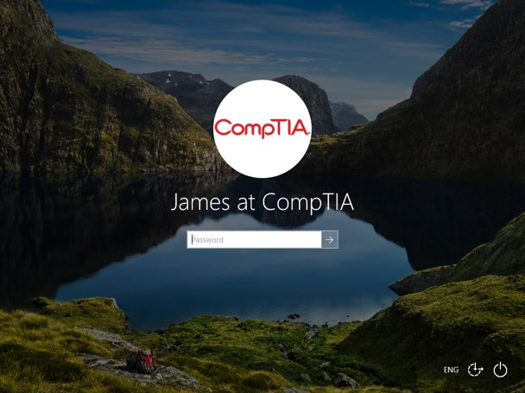
Authentication Design​
Meet requirements for confidentiality, integrity, and availability​
Keeps credentials secure​ (confidentiality
Threat actors cannot bypass or subvert the authentication mechanism​ (integrity​)
Mechanism does not cause undue delay or support issues​ (availability​)
Something you know​: knowledge factor​
Password​
Personal identification number (PIN)​
Screenshot used with permission from Microsoft.
Notes:
Discuss problems with password-only systems before moving on to stronger authentication mechanisms.

Slide 67
Password Concepts
Length​
Complexity​
Character combinations​
Aging​
Reuse​ and history
Expiration
NIST guidance​
Password hints​
Notes:
Students should appreciate that the exam objectives regard complexity and aging as appropriate policies, but make them aware of the updated NIST guidance.
Get students to research password breaches. Explain that these breaches have given threat actors a huge database of hashes and/or plaintext passwords plus emails or usernames to exploit in password spraying attacks.

Slide 68
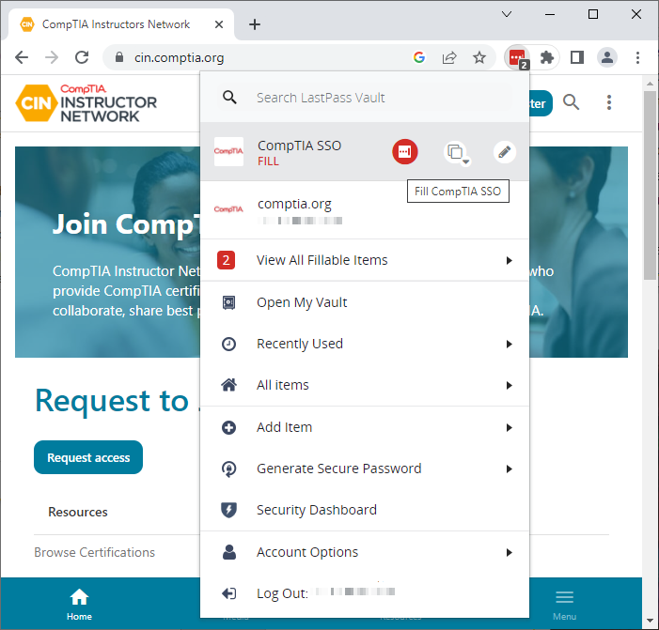
Password Managers
Vault and master password
Built-in OS/browser password managers
Third-party cloud/plug-in
Per-site password generation
Secure filling
Notes:
Explain that password managers facilitate the use of longer and more random passphrases than a user could remember. The apps do have vulnerabilities though.

Slide 69
Multifactor Authentication​
Multifactor authentication (MFA)​
Something you KNOW and something you HAVE​
NOT something you KNOW and something else you KNOW
Something you have​
Ownership factor​: hardware tokens and fobs​
Something you are/do​
Biometric factor​​​: fingerprint and facial scans
Somewhere you are​
Geolocation via location services​
IP/network location
Notes:
Explain how other factors can be used with a username/password to implement MFA.

Slide 70
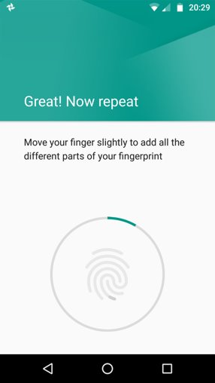
Biometric Authentication​
Enrollment​
Sensor and feature extraction​
Sensor/camera types
Efficacy rates and considerations​
False Rejection Rate (FRR) or Type I error​
False Acceptance Rate (FAR) or Type II error​
Throughput, cost, and inaccessibility
Fingerprint recognition
Facial recognition
Android is a trademark of Google LLC.
Notes:
The latest exam objectives don't have the same level of detailed subobjectives for authentication factors. However, the metrics are listed in the acronyms list so we have included them here.
You might want to note the use of CAPTCHA here too. This isn't a content example, but it is in the acronyms list and included as a glossary term. CAPTCHA is designed to ensure that a human user is making the request or submitting a password, rather than a bot or script.

Slide 71
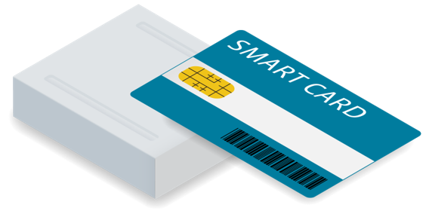
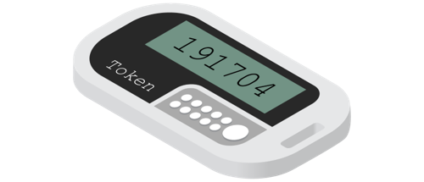
Hard Authentication Tokens
Token generation types
Certificate-based (requires PKI)
One-time password (OTP)
Fast Identity Online (FIDO) Universal 2nd Factor (U2F)
Authenticator form factors
Smart card
One-time password (OTP)​ fob
Security key
Activation method to show presence
Image © 123RF.com.
Notes:
Hopefully students have a good grasp of cryptography from the previous lesson. You might want to remind them of why the properties of a key pair make it suitable for signing operations.
Multifactor authentication is a strong solution but can also be an expensive one. Along with hardware and software costs, there may be additional support costs when authentication fails and a valid user cannot access the network.
FIDO/U2F is not a subobjective, but it is worth mentioning in terms of general awareness of token key methods and the journey toward passwordless/FIDO2/WebAuthn.

Slide 72
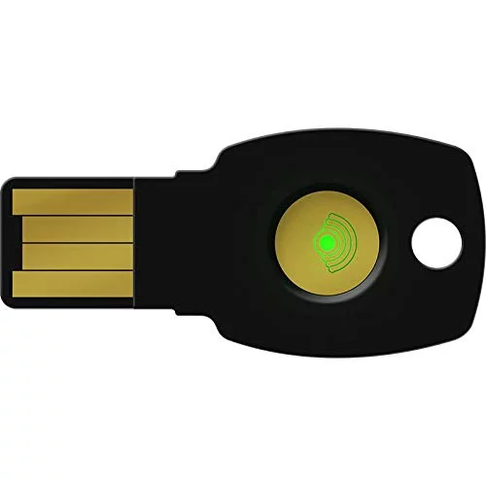
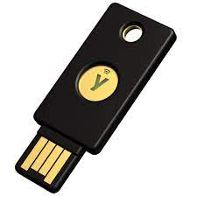
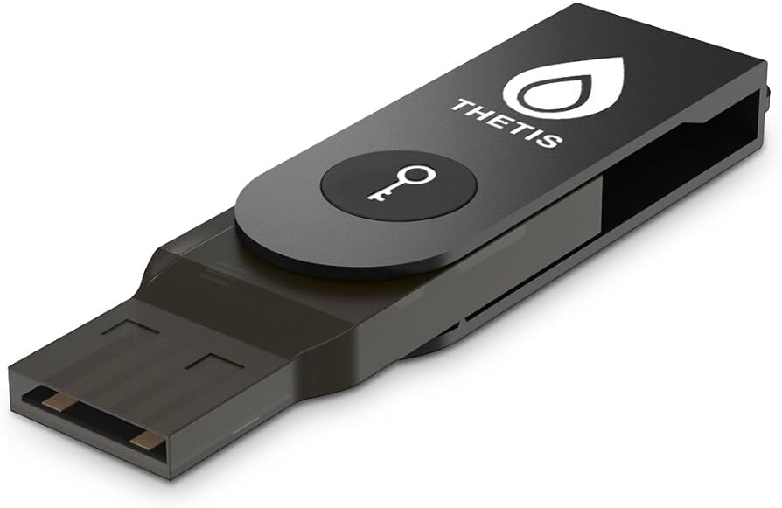
FIDO: Fast Identity Online
Fast Identity Online (FIDO) advances digital security beyond the conventional password with passwordless authentication methods.
FIDO Passwordless authentication uses biometrics and PKI
NIST defined Authenticator Assurance Levels (AAL)
AAL1 is username and password
AAL2 is MFA
AAL3 uses hardware-based mechanisms
https://fidoalliance.org/cloudflare-embraces-fido-to-help-its-own-security/

Slide 73
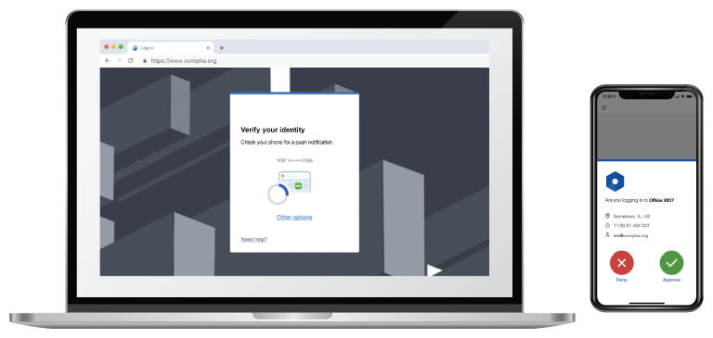
Soft Authentication Tokens
Transmit a code via an out-of-band channel​
Short message service (SMS)​
Email account​
Phone call​
Push notification​
Authenticator app
Possibility of interception​​
Notes:
The term "two-step verification" is not on the objectives document, but students should understand the difference between these mechanisms and hardware token keys.

Slide 74
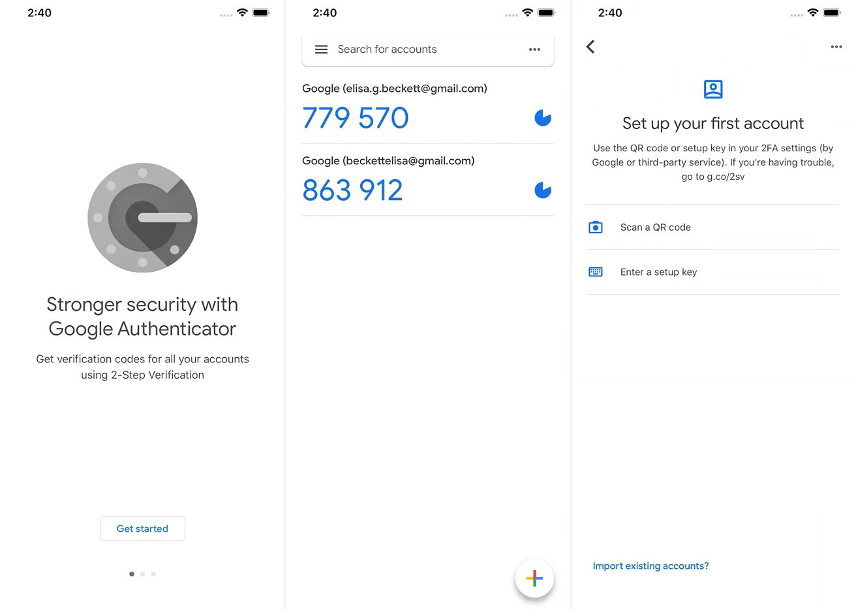
Passwordless Authentication
Rely on authenticator rather than password
Accounts identified by public/private key pair, but doesn’t have to use PKI
Private key stored only on authenticator
Authenticator can require biometric or PIN proof of presence (local gesture)
Attestation
Verify authenticator as root of trust
Notes:
Note that MFA retains use of a password along with a token and/or biometric authenticator as an additional factor. Passwordless depends on use of an authenticator only.
As it's not on the exam objectives, we haven't mentioned Client to Authenticator Protocol (CTAP) or CTAP2. You might want to point out that the framework needs a secure way for a web browser to exchange data with an authenticator.
Make sure students understand the difference between attestation and authentication. Attestation involves proving that the device platform has a secure root of trust and can report its properties truthfully.

Slide 75
Authentication
Authentication design​
Something you know/are/have
Password concepts and password managers
Multifactor authentication​
Biometric authentication​
Hard authentication tokens
Smart cards, OTP generators, FIDO U2F
Soft authentication tokens
Two-step verification
Passwordless authentication

Slide 76
Discussion time: Please type your questions in chat
Questions over content.
Share you experience.
What would you like to see different moving forward?
Let’s keep the conversation going in the CompTIA Instructor Forum: https://cin.comptia.org

